Slide 1
NFT-Create for VR: Persevering and Protecting the Artistic Process in NFTs through In-App Integration of Minting and Selling

Slide 2
Introduction/Problem Space
NFTs ( Non-Fungible Tokens) virtually represent the owner of a unique asset.
NFTs are most popularly used to represent virtual art.
Currently, the NFT is awarded to the person who mints it even if it not the creator of the digital art [2, 3, 6, 8].
We created a tool that consolidates and simplifies the minting process to solve the theft issue and builds in authentication
Notes:
This means each token is completely unique and cannot be copied or recreated
An NFT is hosted on a blockchain, of which the most common is Ethereum
A blockchain is a distributed ledger of transactions
Each block on the chain is one transaction between two crypto addresses
Ethereum’s blockchain is unique, as it supports entities other than its native coin--such as NFTs and other cryptocurrencies

Slide 3
Users and User Needs
User
Digital Artists
No specific demographic group
Sprinklr Data showed overwhelming negative sentiment towards NFTs
Recognition of some benefits
Creation
Easy to use interface
Authentication, NFT minting, and other use of system should not inhibit creative process
Security
Establishment of ownership of work
Prevention of counterfeit and sale of work via NFT [3, 8].
Notes:
To evaluate user needs, we did a large data scrape of posts from several online sources using key terms “NFT” and “art theft” from the past year
We chose the past year 1) to limit the sheer number of posts we were looking through and 2) determine current sentiments as the topic has only recently grown in discussion
Around 93% of posts had a negative sentiment towards the topic
Recent article from researchers at University of Illinois at Urbana-Champaign reiterated our informal findings on user sentiments towards NFT technology
Recognized benefits such as the supporting of creativity, democratization of commercialization (no middleman), community support.
Also discussed the possible harms NFTs may pose to artists who try to protect their work
Challenges included limited understanding of blockchain and NFTs and lack of moderation and authentication on marketplaces

Slide 4
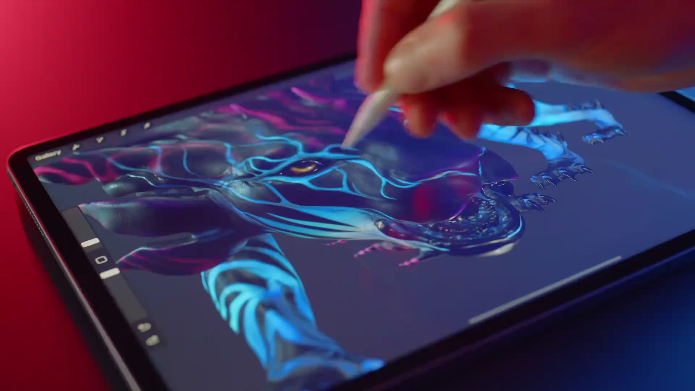
Art Creation Interface
Interface
Needed an interface that was simple and already familiar with users
Investigated current platforms in both VR and other hardware
Procreate [1]
Top paid art creation app for iPhone
Top paid app for iPad
Notes:
Source for procreate statistic - https://appfigures.com/top-apps/ios-app-store/united-states/iphone/top-overall
Talk about VR Portion

Slide 5
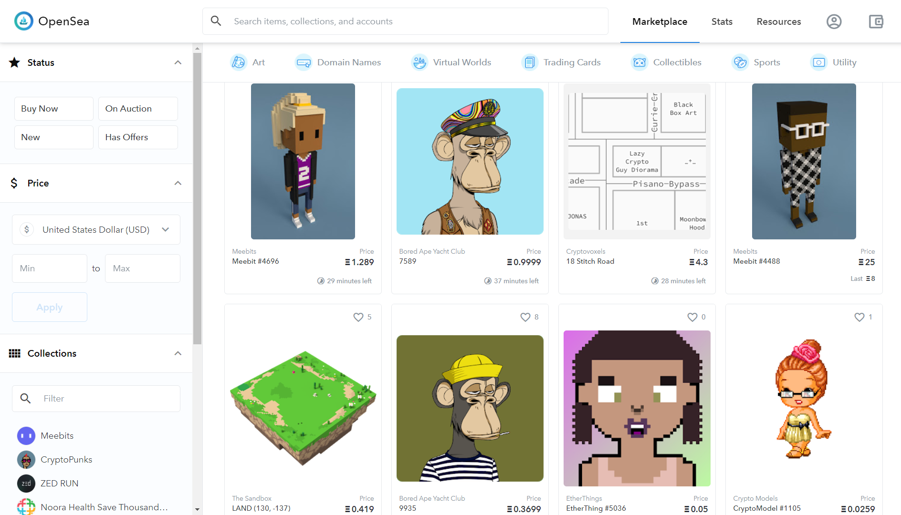
User Marketplace Interface
Investigated existing spaces like Opensea for design recommendations.
Implemented basic features of marketplaces that already exist. For example, simplistic UI to reduce distractions.
Main components:
Upload the art
List the art
Buy/sell the art
Notes:
What is already existing (Opensea) and what needs to be improved.
Upload : Where you create the art, provide the blockchain you wish to put it on
List art: place your art onto the marketplace for a specific amount you wish to sell it for

Slide 6
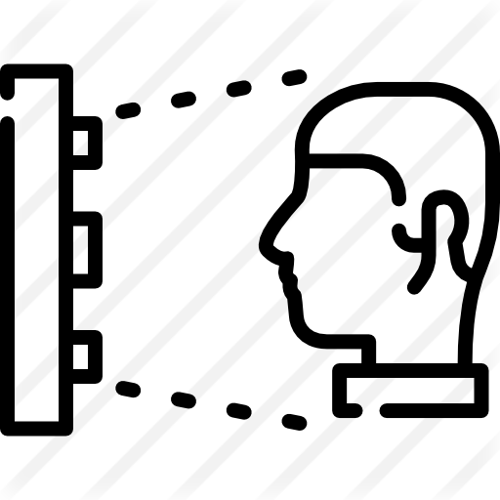
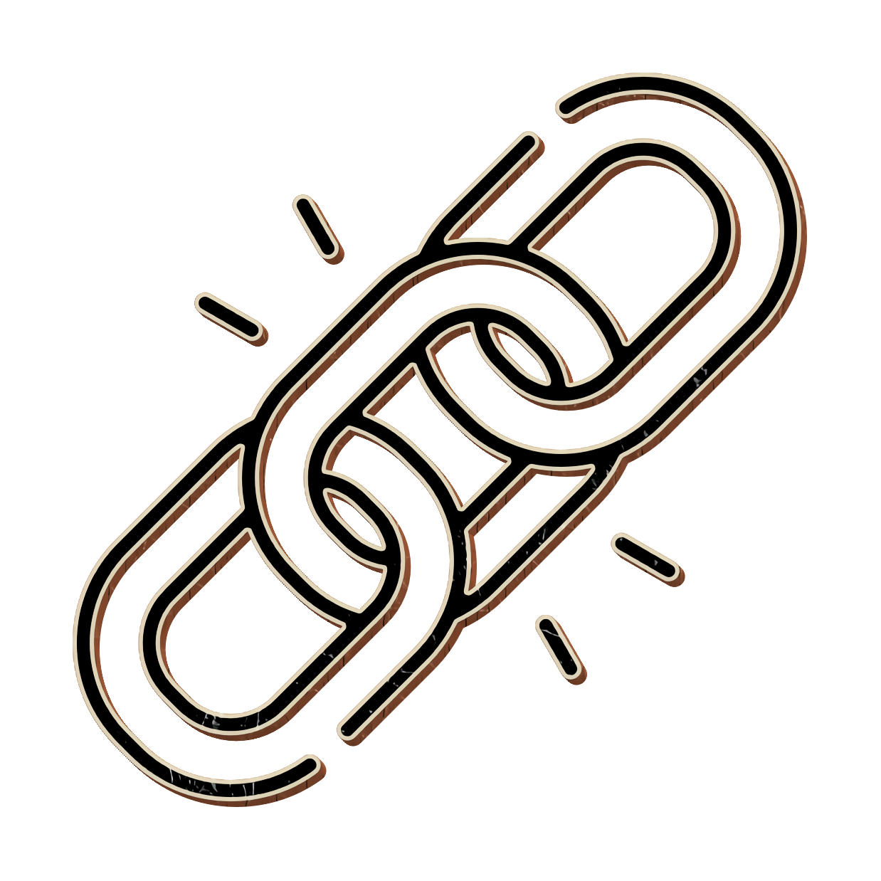
Security Solutions
Authentication
Automatic Biometric Authentication
BlockChain
Creates NFT immediately
Notes:
The biometric authentication prevents others from accessing unreleased projects and creating new blockchains without permission.
By using a blockchain, the NFT of the art piece is created immediately and cannot be affected by anyone else.

Slide 7
Task Timeline
Macrotask 2: Create Art and Blockchain
Macrotask 4: Adjust Listing
Macrotask 5: Logout
Macrotask 1: Login and Open Project
Macrotask 3: Upload to Marketplace

Slide 8
Testing Measurements
Time on Task
Time recorded to do each macro-task
Digital artists expresses speed as an important factor in a platform
Speed could impact business
Error Rate
Precision of Controls
Lack of lag for inputs
Errors can interrupt “artistic flow”
Correctness of Listing
Satisfaction Rating
Nielson’s 10 Usability heuristic evaluation
Questions derived to measure artistic flow

Slide 9
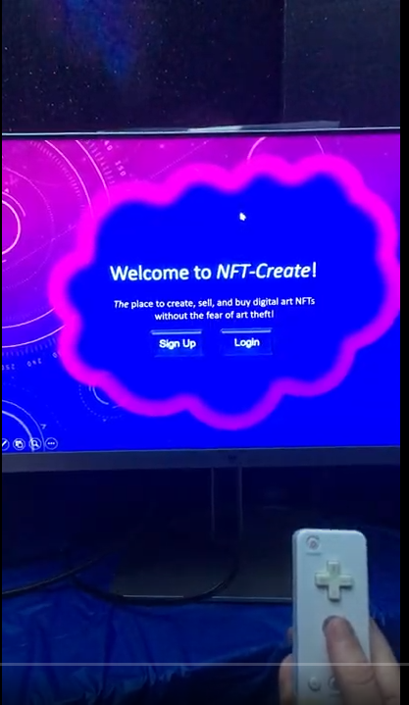
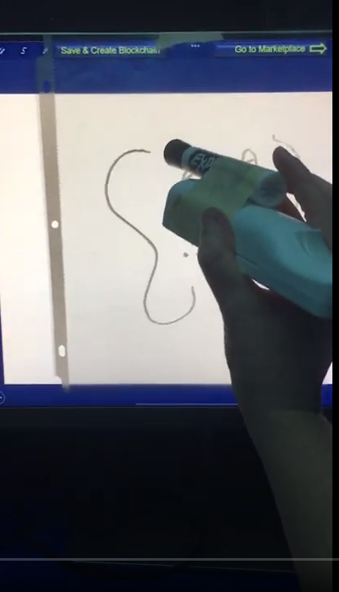
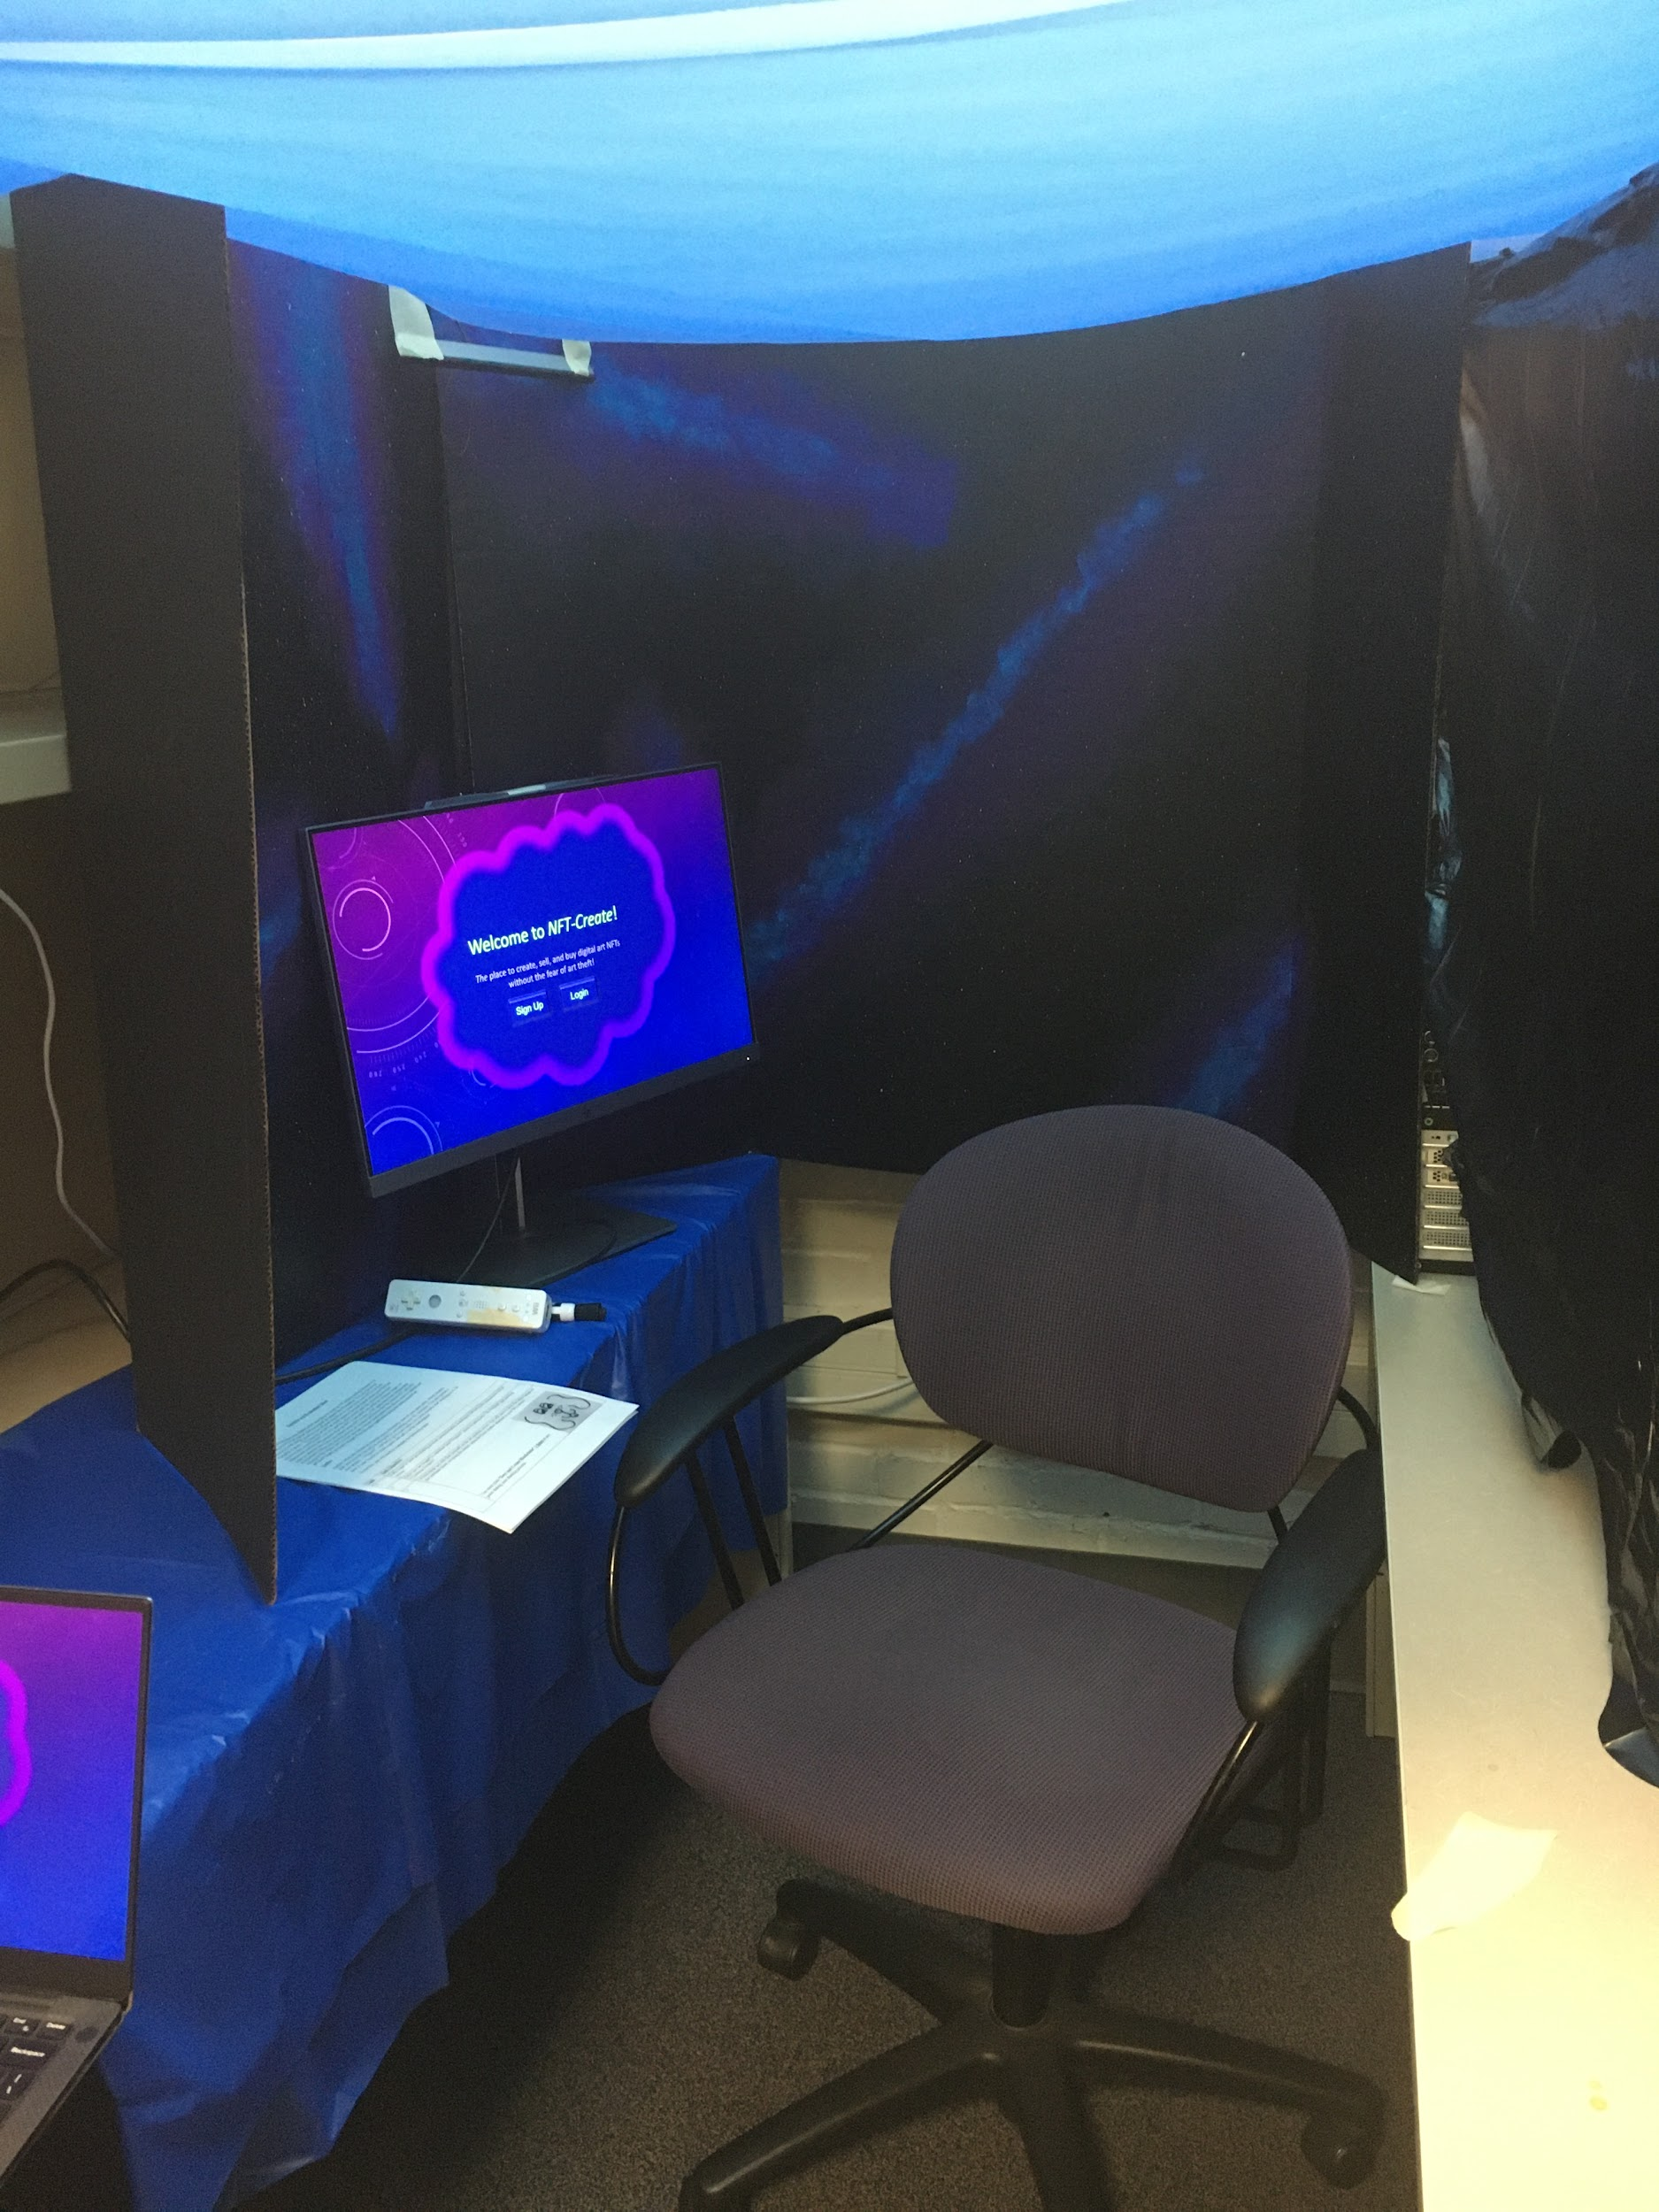
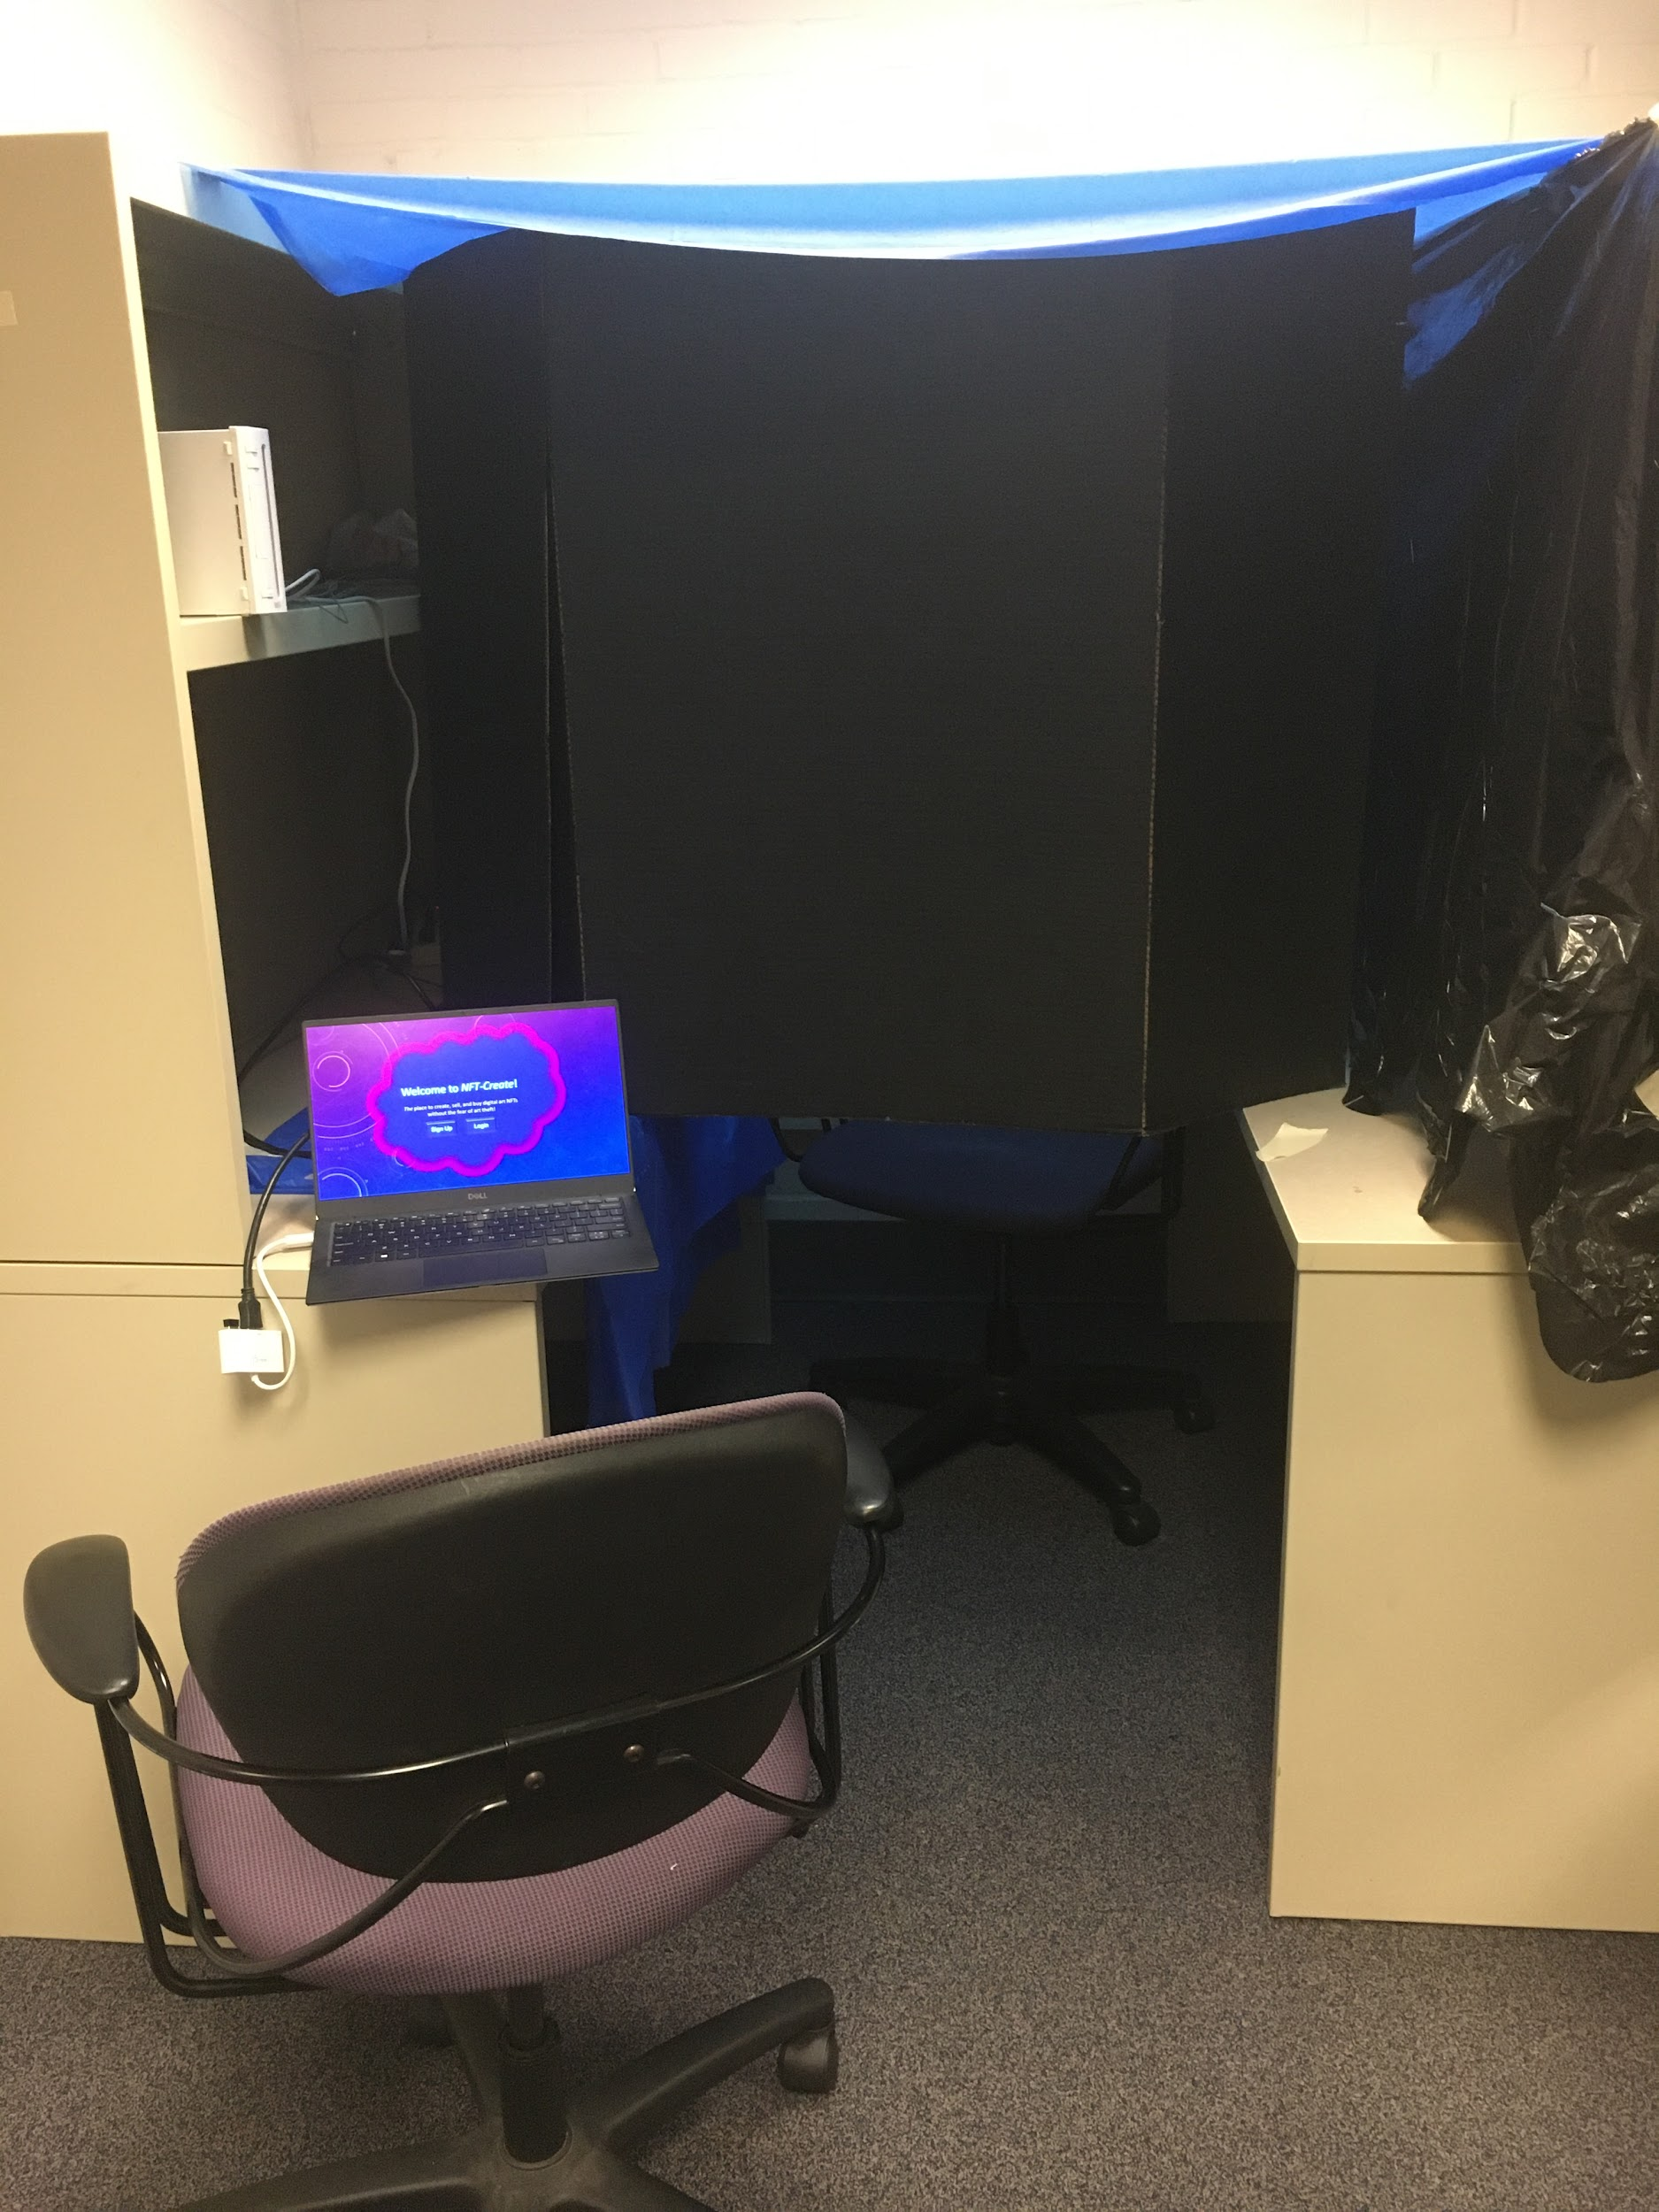
Prototype Evaluation Environment

Slide 10
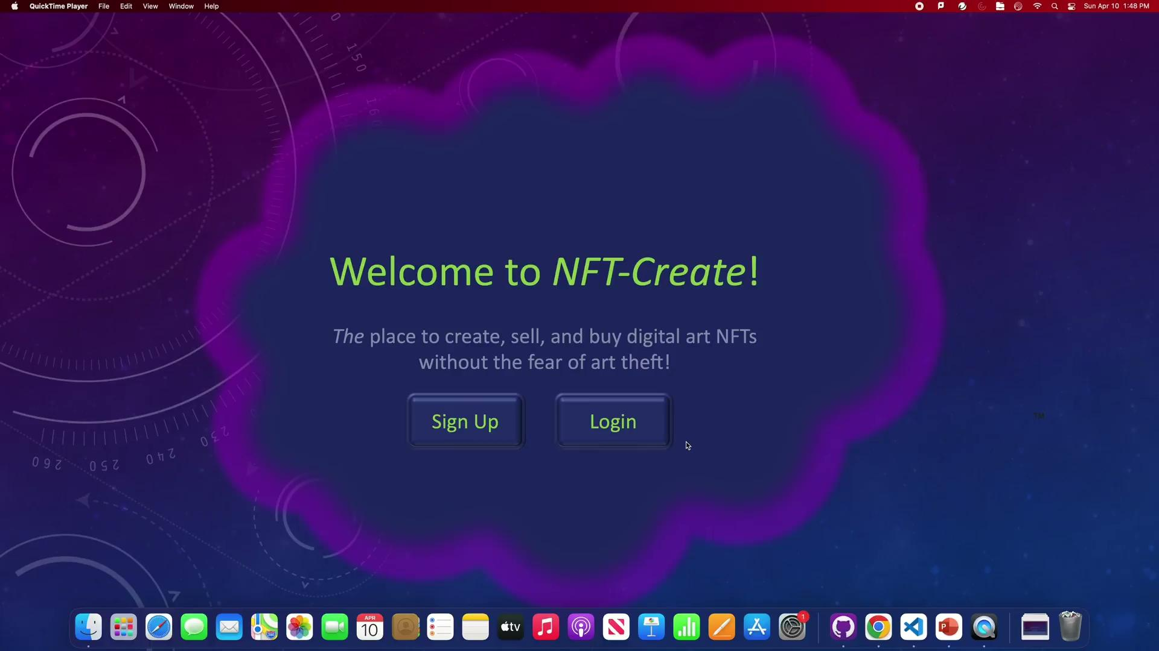
Prototype Walkthrough

Slide 11


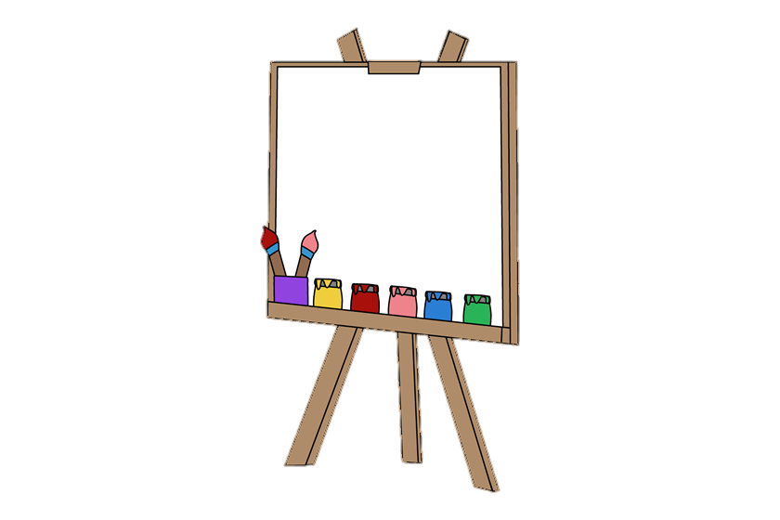
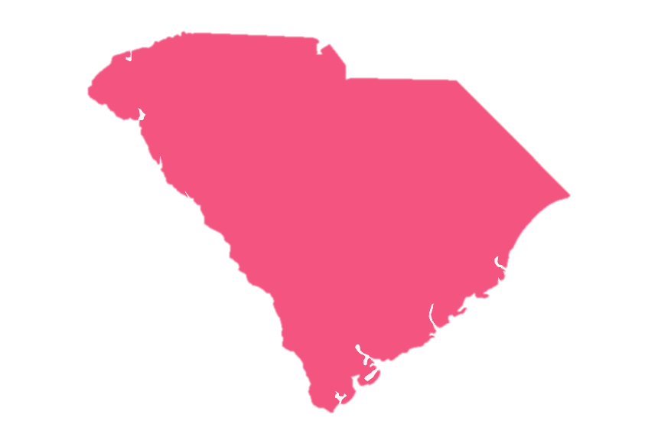
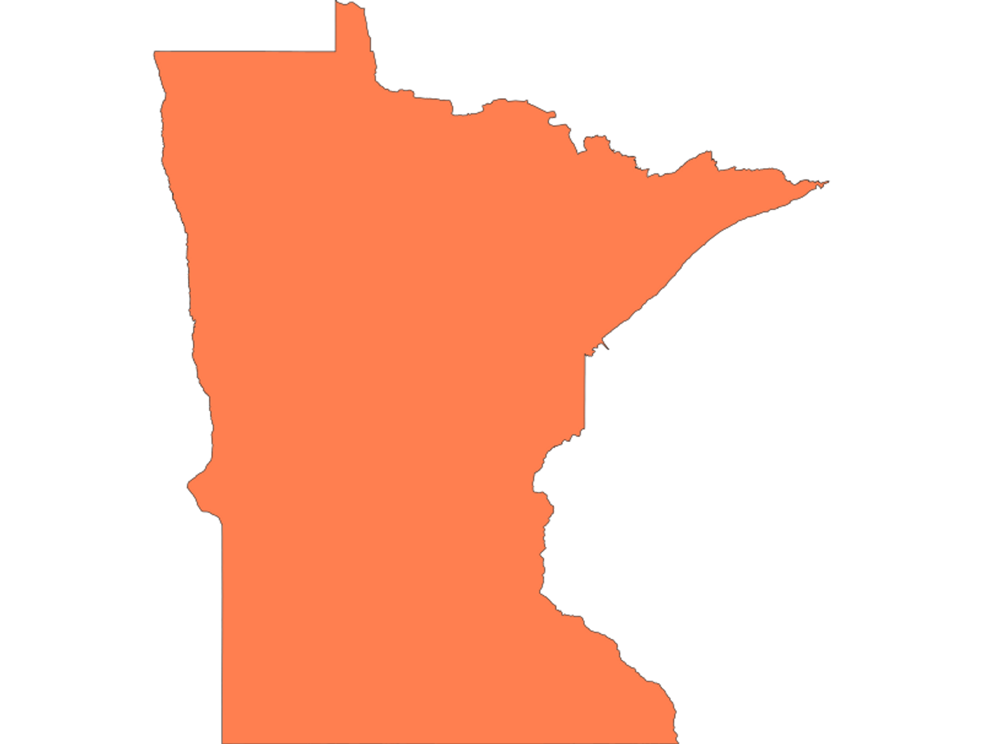
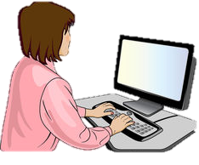

Participant Demographics
Ethnic Identity
White = 60%
Black/African American = 20%
Asian = 20%
Age
Gender Identity
21 - 25yo
= 60%
= 40%
Artistic?
Homestate
Program
40%
Yes
60%
No
80%
20%
80%
20%

Slide 12
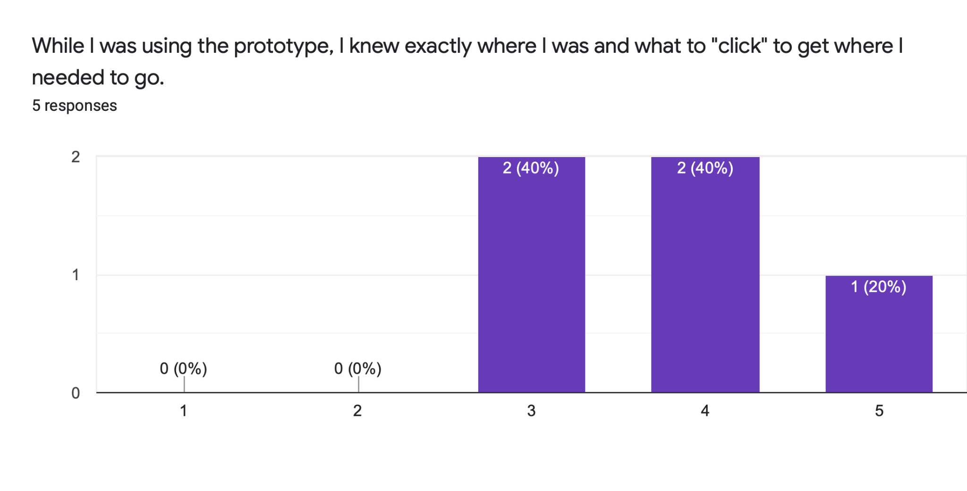
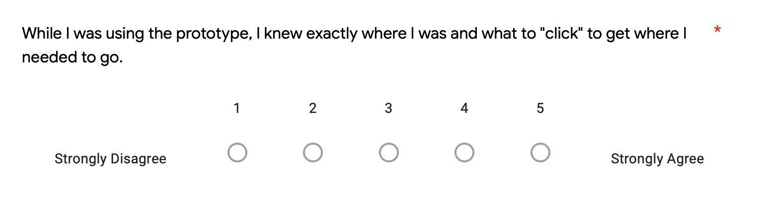
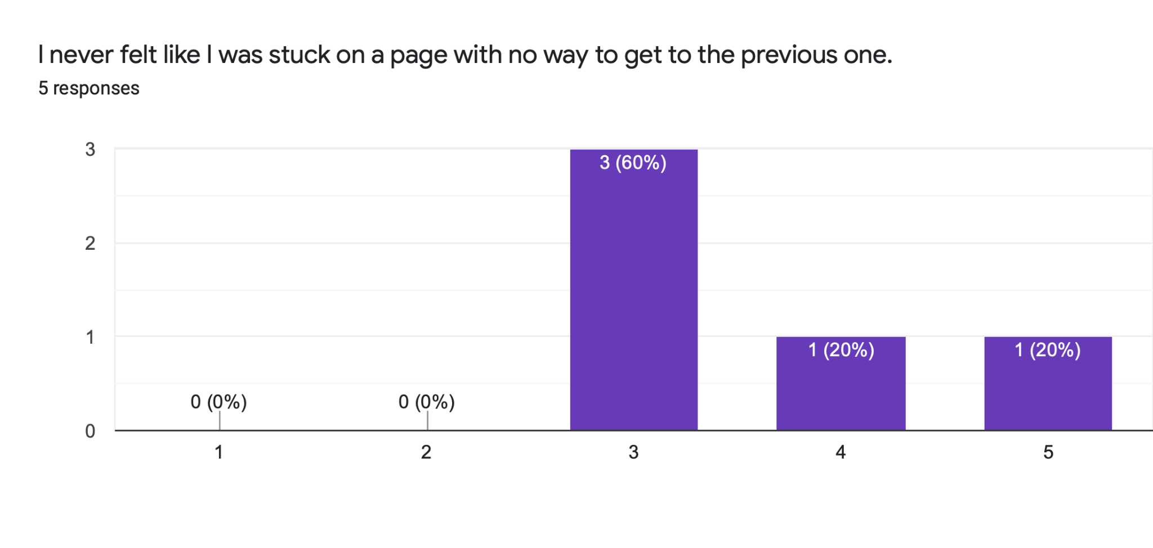
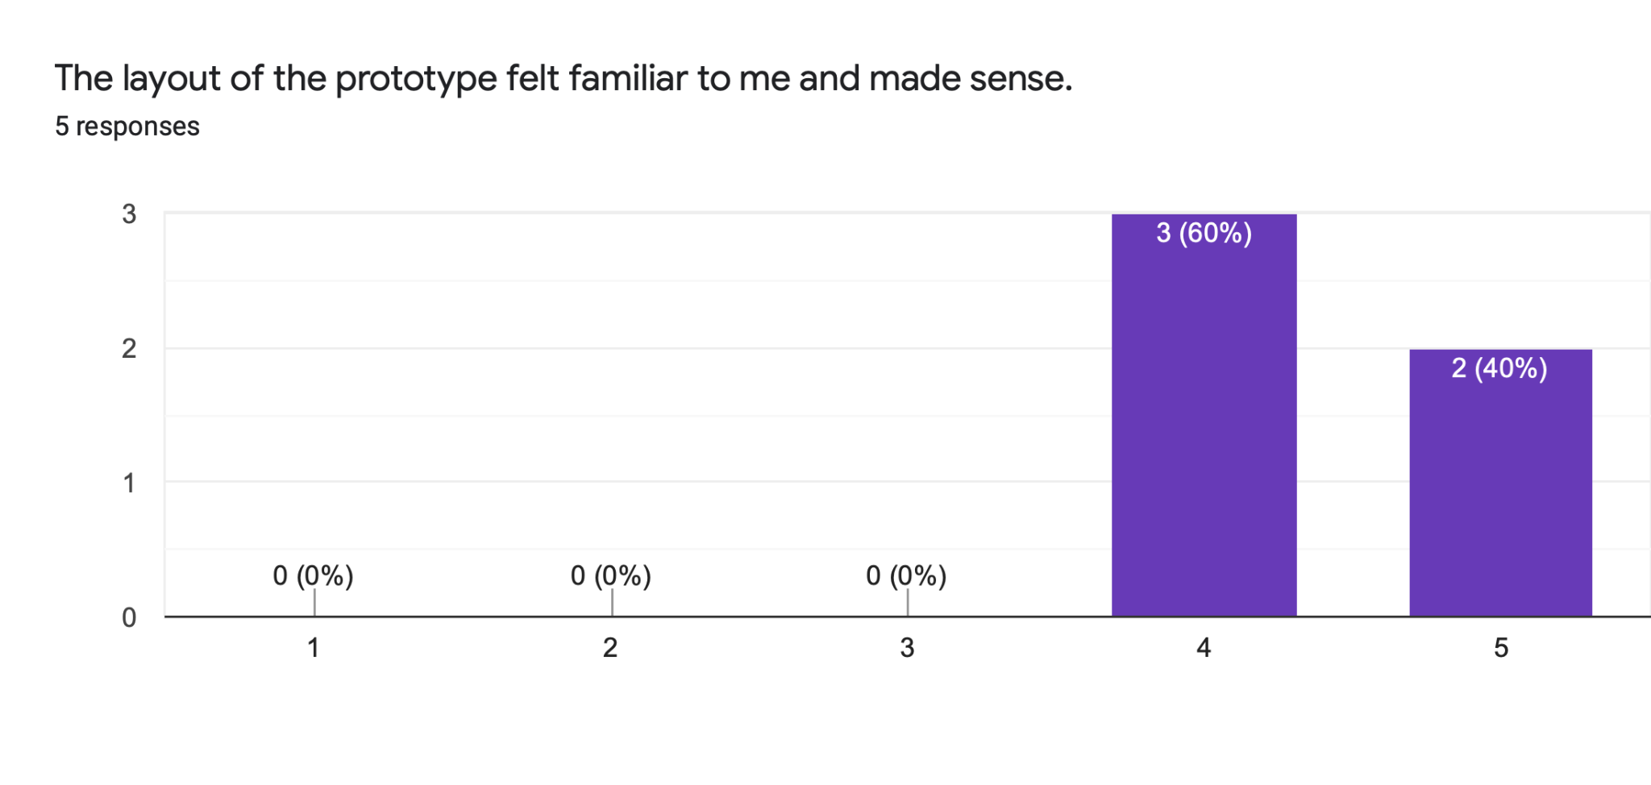
Heuristic Evaluation
Sample Question
Question 13; Average response = 3.8
Question 15; Average response = 3.6
Question 14; Average response = 4.8
Notes:
After participants completed the series of tasks, they completed a survey that used Likert scales to measure UI Heuristics and artistic flow viability. Our heuristic questions followed Nielson’s 10 usability heuristic evaluation requirements and we asked questions such as “While I was using the prototype, I knew exactly where I was and what to "click" to get where I needed to go” and “I never felt like I was stuck on a page with no way to get to the previous one” which provided insight on user control and freedom as well as flexibility and ease of use. The slide shows an example of 3 questions that were on the survey as well as their results so we can demonstrate how we analyzed responses:
As shown in the response charts, participants felt the system had a relatively close match to their previous experience as the average familiarity response was a 4.⅘. However, the 13th and 15th question had lower average responses at 3.8 / 5 and 3.6 / 5 respectively. These questions measure how much control and flexibility users feel they have while using the system so these lower numbers indicate that we need to add more error resolution paths in the form of back buttons and that we should adjust the interface to make sure it was intuitive. These adjustments can include things like making a larger home button that incorporates color contrast to make it stand out to the user. In addition, we can change the text on our buttons to better reflect where they lead to. For example, when the user is uploading their artwork to the marketplace, they must click 2 “continue to listing” buttons in a row that do different things. We can change the name of the first one to “Save” to better indicate the function of the button.

Slide 13
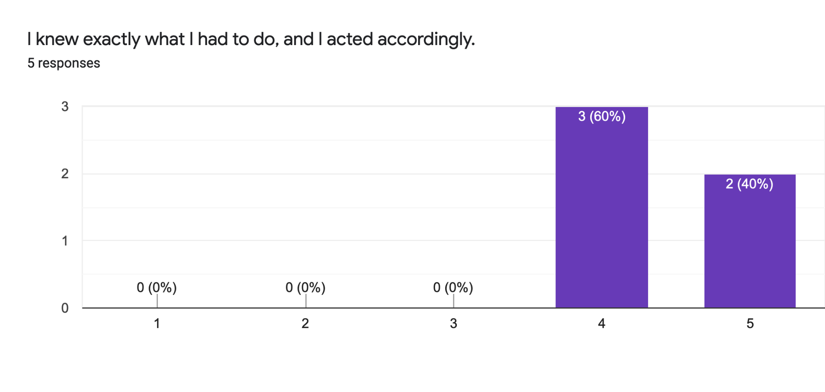
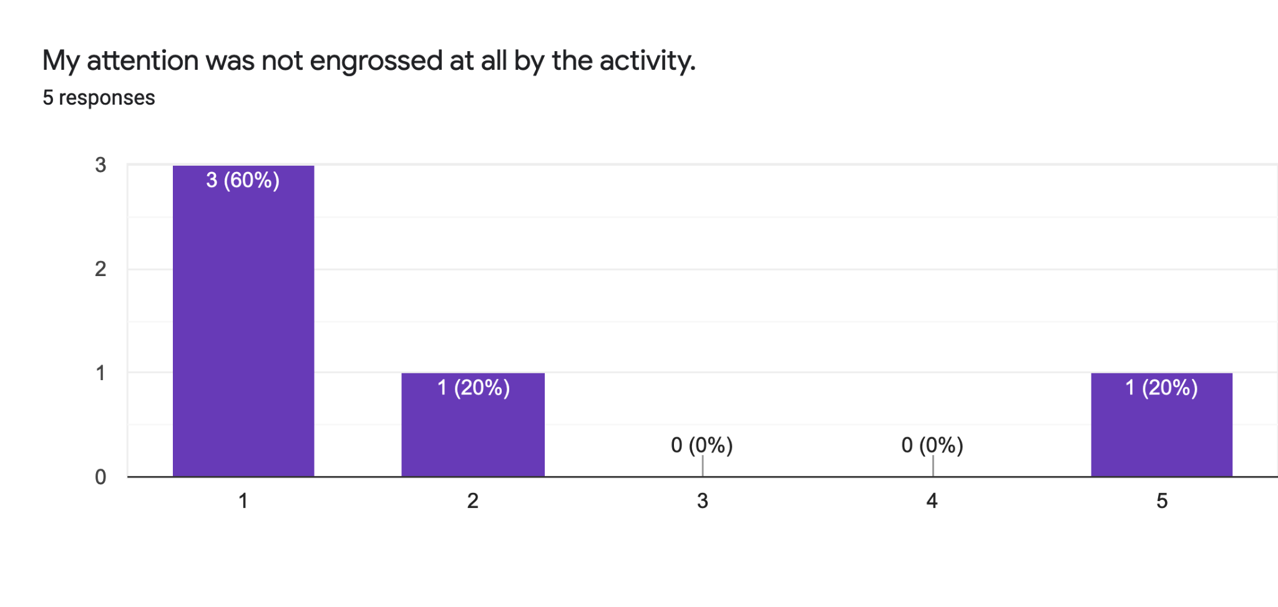
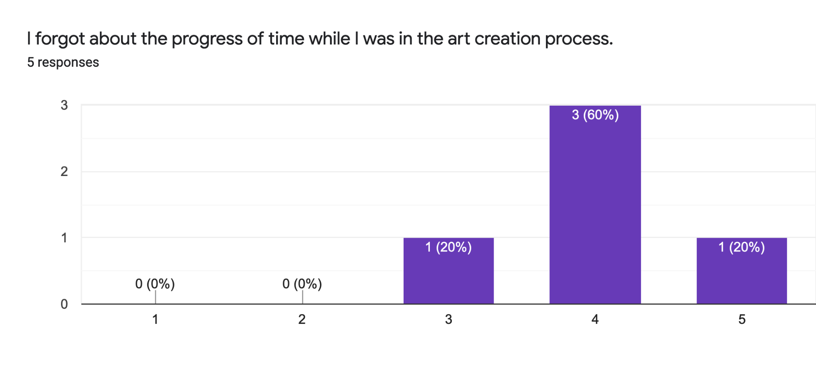
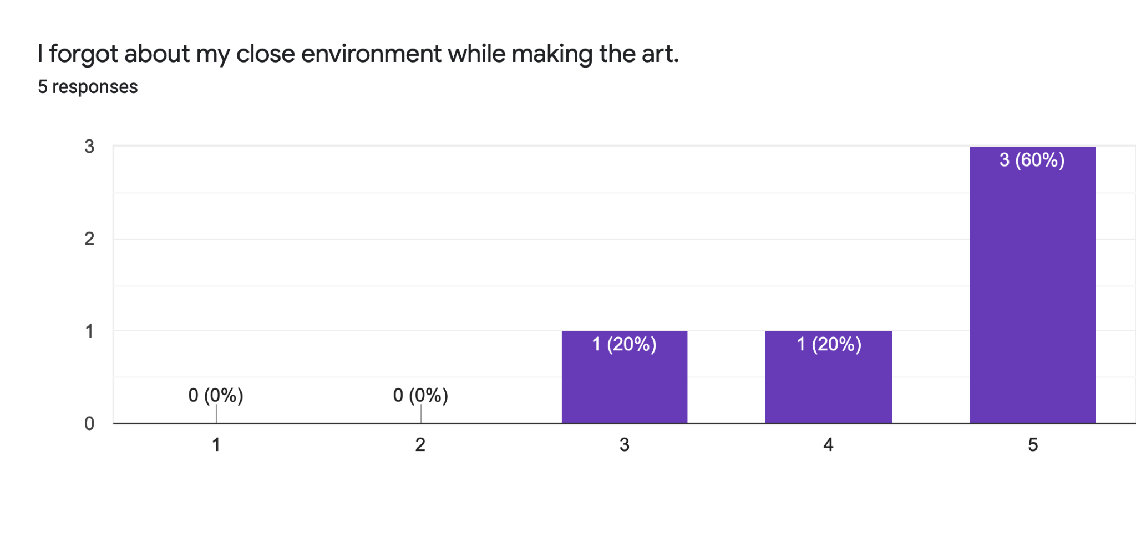
Artistic Flow Evaluation
Question 4; Average Response = 4.4
Question 7; Average Response = 2
Question 8; Average Response = 4
Question 11; Average Response = 4.4
Notes:
Along with the earlier Heuristic evaluation based on the Nielson’s 10 requirements, we also measured how the system impacted artistic flow, as one of our user needs is that the prototype should not hinder the creative process.
Artistic flow is a subjective term and we based 12 questions on a paper that outlined a questionnaire to determine if someone had entered a “flow state” and adapted them to fit art creation more specifically
This paper matched up with some blogs that we had also found in which artists had talked about time in which they achieved an artistic flow
Here I have pulled a few questions that had some either unexpected results or results that may help us think about future prototypes.
Overall users often strongly agreed with statements that would indicate that they experienced artistic flow such as forgetting about the passage of time or that they forgot about their close environment while making the art. As seen in questions 8 and 11
However, some of the data also shows that the prototype has room for improvement. With a perfect prototype, all users would have responded with a 5 for question 4. The fact that 3 users scored this question with a 4, shows that there are some elements of the prototype or process that may have left those users confused
Another question result that stood out to us was the result for question 7. Ideally, we would want users to strongly disagree and be engrossed by the activity. The lone outlier for this question could either show that the prototype lacked in that area or that the question was unclear in that it was a negative statement.

Slide 14
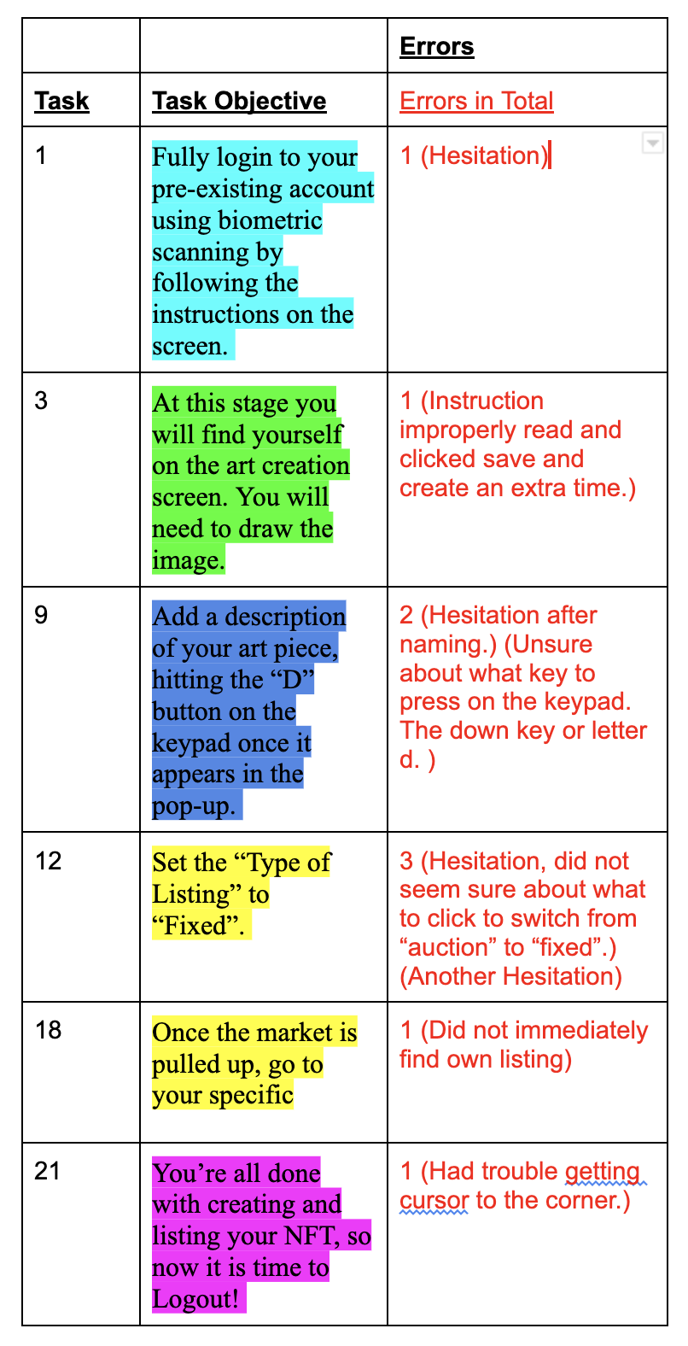
Error Rate and Time on Task
Error Rate
Time on Task
Macrotask 1 Login and Open Project: 00:48:52
Macrotask 2 Create Art and Blockchain: 02:00:75
Macrotask 3 Upload to Marketplace: 01:06:92
Macrotask 4 Adjust Listing: 00:52:81
Macrotask 5 Logout: 00:49:53
Average Time on Total Task
05:50:88
Notes:
During our user testing we found that the average rate for completing the total simulation was 05:50:88. Listed above the average for the total time are the breakdowns for each Macrotask which consists of all the tasks within a certain group of tasks. As you can see most of the tasks took less than one minute to complete outside task 2 and 3 on average. The chart represents the completion rate for each user according to their completions of the tasks, but since no one failed to complete a task we counted hesitation as an error in this instance. Since it was recorded that some users hesitated it shows us that some of the design features within the art creation software can become more noticeable or more efficient. Since it was originally not as noticeable or efficient it caused them to hesitate on some tasks.

Slide 15
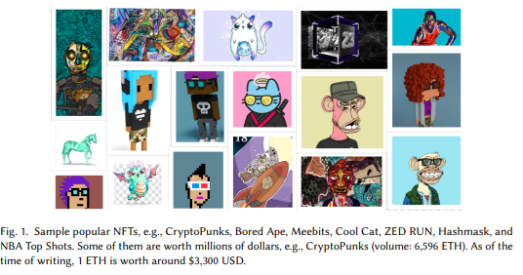
Implications of Results
Previous research largely focuses on the technical [4, 7, 9] and economic [11] implications of NFTs.
Unique focus on the artistic perspective
Feb. 2022 [10] article highlighted technological competency and quality/scamming issues, but not security of ownership

Slide 16
Implications of Results
“As someone who does create digital art I found this to be really cool and would love to see something like this for real as a way to protect digital art creation and better facilitate artists making money from their work and protecting against art theft, which currently is hard to control online. Really great concept!” - P4
Our prototype presents a unique and effective NFT art theft mitigation solution, focused on preserving the artistic process!
Not without limitations and changes though!

Slide 17
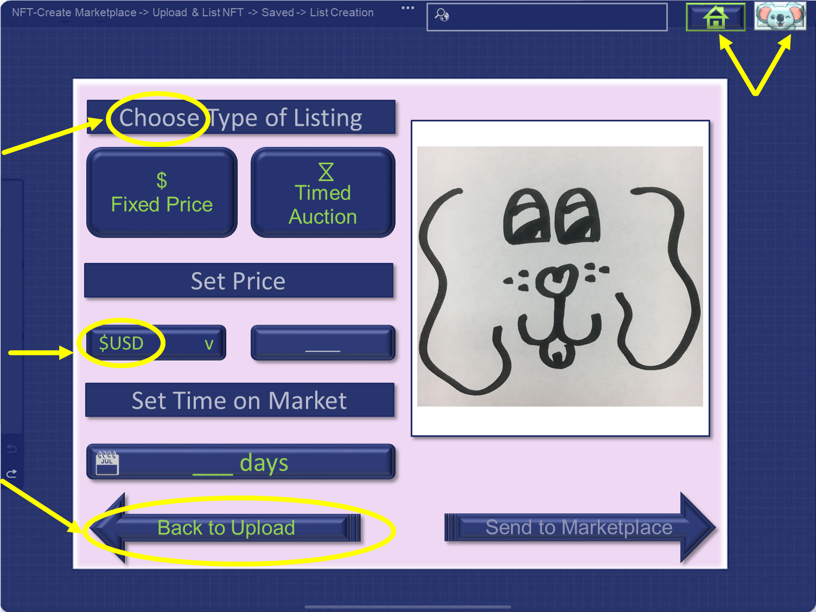
Future Changes
Clearer Instructions
More Prominent & Clickable “Home” and “Profile”
More Intuitive Price Button
Increased Navigation Options

Slide 18
References
[1] appfigures.com. Top Ranked iOS App Store Apps. Retrieved from https://appfigures.com/top-apps/ios-app-store/united-states/iphone/top-overall
[2] Mitchell Clark. 2021. People are spending millions on NFTs. What? Why? The Verge. Retrieved February 1, 2022 from https://www.theverge.com/22310188/nft-explainer-what-is-blockchain-crypto-art-faq
[3] Kevin Collier. 2022. NFT Art sales are booming. just without some artists’ permission. NBCNews.com. Retrieved from https://www.nbcnews.com/tech/security/nft-art-sales-are-booming-just-artists-permission-rcna10798
[4] Michael Dowling. 2022. Is non-fungible token pricing driven by cryptocurrencies? Finance Research Letters 44, (January 2022), 102097. DOI:https://doi.org/10.1016/j.frl.2021.102097
[5] ethereum.org. Non-fungible tokens (NFT). ethereum.org. Retrieved from https://ethereum.org/en/nft/
[6] Andres Guadamuz. 2021. The treachery of images: non-fungible tokens and copyright. Journal of Intellectual Property Law & Practice 16, 12 (December 2021), 1367–1385. DOI:https://doi.org/10.1093/jiplp/jpab152
[7] IBM. What is blockchain technology? - IBM Blockchain. IBM. Retrieved from https://www.ibm.com/topics/what-is-blockchain
[8] Harrison Jacobs. 2022. The counterfeit NFT problem is only getting worse. The Verge. Retrieved from https://www.theverge.com/22905295/counterfeit-nft-artist-ripoffs-opensea-deviantart
[9] Arnav Kapoor, Dipanwita Guhathakurta, Mehul Mathur, Rupanshu Yadav, Manish Gupta, and Ponnurungam Kumaraguru. 2022. TweetBoost: Influence of Social Media on NFT Valuation. arXiv:2201.08373 [cs] (January 2022). Retrieved February 1, 2022 from http://arxiv.org/abs/2201.08373
[10] Sharma, T., Zhou, Z., Huang, Y., & Wang, Y. (2022). “It’s A Blessing and A Curse”: Unpacking Creators’ Practices with Non-Fungible Tokens (NFTs) and Their Communities. arXiv preprint arXIV:2201.13233.
[11] Kathleen Bridget Wilson, Adam Karg, and Hadi Ghaderi. 2021. Prospecting non-fungible tokens in the digital economy: Stakeholders and ecosystem, risk and opportunity. Business Horizons (October 2021). DOI:https://doi.org/10.1016/j.bushor.2021.10.0076:26

Slide 19
Questions??

